Slide 1
British Airways Reviews Analysis
11/1/2025

Slide 2
Content
Introduction
Dataset overview
Methodology
Sentiment analysis
Topic analysis
Satisfaction analysis
Word cloud
Conclusion and insights
Q&A

Slide 3
Introduction
Background
As the flag carrier airline of the United Kingdom, British Airways attaches great importance to providing high quality services to passengers. Through the analysis to customer reviews, we can find insights on how to improve customer satisfaction, service quality, and brand building.
Aim
Sentiment analysis: analyse what is the general sentiment tendency.
Topic analysis: discover the hidden topics in the extracted reviews.
Satisfaction analysis: assess overall customer satisfaction.

Slide 4
Dataset overview
Data source: reviews data is extracted from a third-party review website called Skytrax. We used web scraping method to extract reviews in the form of text data from a certain url from Skytrax: https://www.airlinequality.com/airline-reviews/british-airways, and stores the data in a csv file.
Sample size: 1000 reviews was extracted in total for this analysis. These reviews were written from August,2019 to January,2025. Only the text part of the reviews were collected.
Data preprocessing and cleaning: removed non-alphabetic characters, transferred it into lowercase, removed stopped words

Slide 5
Methodology
Sentiment analysis:
We used textblobas the tool to conduct this analysis. Through the analysis of the affective tendency of each review, find the sentiment distribution of the sample data.
Topic models:
This step is to find different hidden topics in the sample data. By showing and exploring the keywords and frequent showed word in each topic, we can find the major top structure and semantic meanings.
Satisfaction analysis:
The result of sentiment analysis were converted into scores and the overall satisfaction was calculated as the score from 1 to 5. The higher score represents a higher satisfaction level.
Word cloud analysis:
An image demonstrates words that frequently appears in the reviews in an illustrative way. The larger the word is, the more frequent the word appears in reviews. This method shows the major topic and key words intuitively.

Slide 6
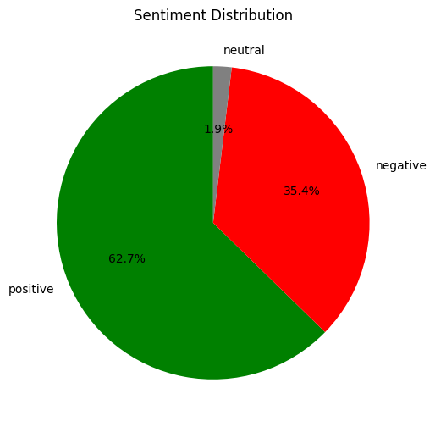
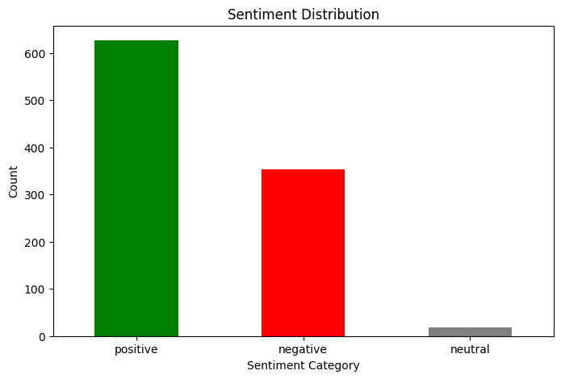
Sentiment analysis
Analysis objective: To understand the overall customer satisfaction with British Airways.
Analysis process: analyze each entry of the reviews in the sample data. And assigned a sentiment score according to this rule: very positive: 1/neutral: 0/very negative: -1.
Emotion classification: classify all the reviews into 3 groups according to their scores for further analysis.
Result:
We conduced sentiment analysis on 1000 reviews, 627 of them are categorized as positive, 354 of them are negative, and only 19 reviews are neutral.
From the pie chart and the bar chart, we can see that most customers hold a positive attitude to their experience with British Airways, with a neglectable amount of customer holding the neutral attitude.
Limit:
This result is made only based on the sentiment scores. Even if a score like -0.056439 is also categorized as positive and vise versa.

Slide 7
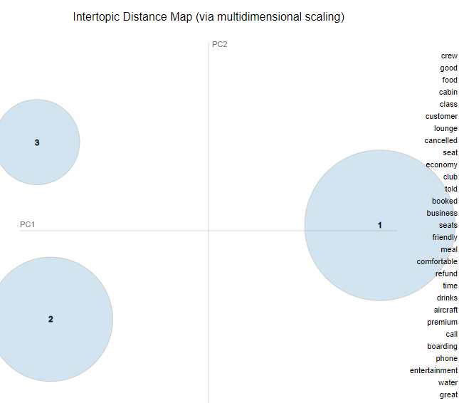
Topic analysis
Topic 1 | Topic2 | Topic 3
Cancelled | Seats | Experience
Airport | Time | Seats
Airline | Cabin | Good
Would | Seat | Economy
Get | Business | Seat
Told | Crew | Service
Hours | Food | Time
Customer | Service | Cabin
Airways | Class | Food
Service | Good | Crew
Tool: LDA model and pyLDAvis
The LDA model is used to analyze potential topics in the comments, and pyLDAvis is used for visualization.
Result and visualization:
we found 3 separate topics in total from the sample data. The keywords on each topic can be found in the chart above.
The distance between the circles in the visualization represents the difference between the subjects. The larger the circle, the more the topic appears in the data set. Although some key words are same among the 3 topics, we can see that these three topics are holding a distance in the quadrantal diagram. There are still 3 separate topics in our sample data.
The words at the right side in the visualization represents the top-30 relevant term for the 3 topics.

Slide 8
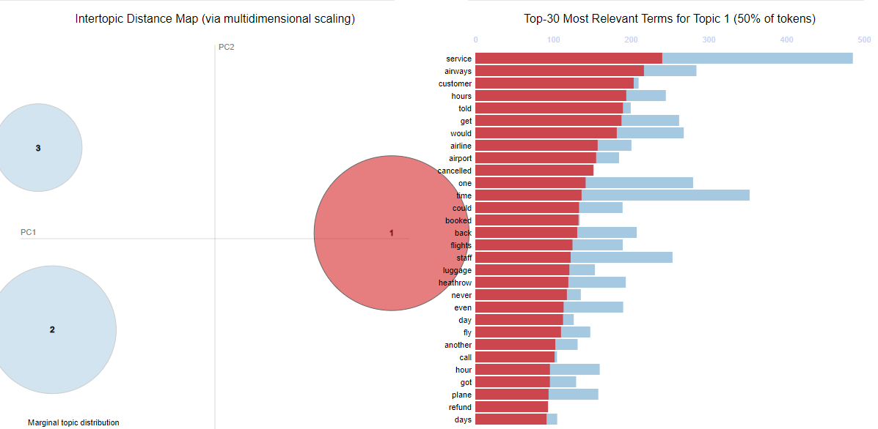
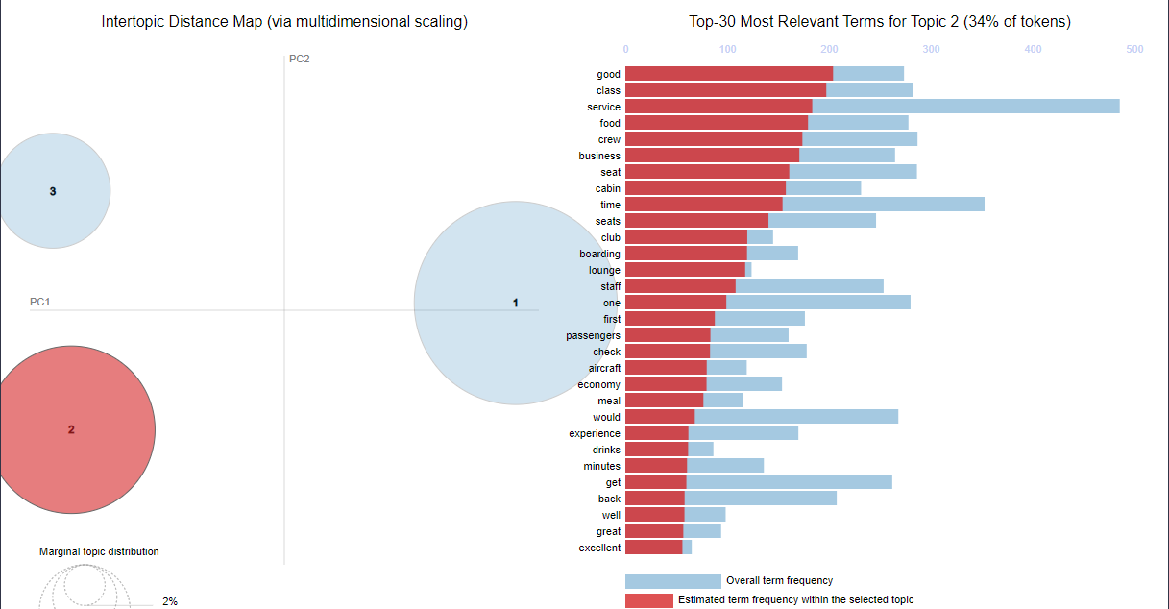
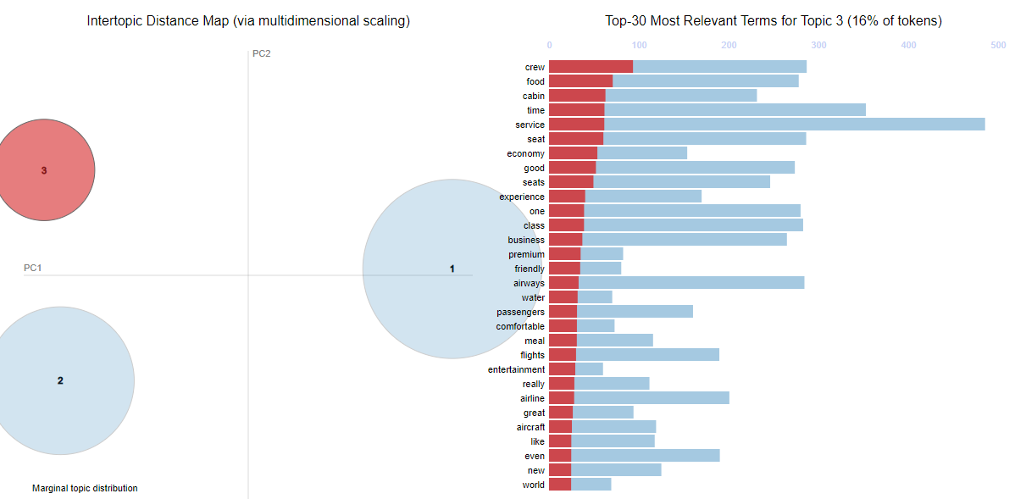
Topic analysis
We concluded the potential sematic meanings on each topic according to the key words and most relevant terms of each topic:
Topic 1:
This topic mainly deals with flight cancellations and related customer service issues. As a whole, this theme reflects customer experiences and perceptions of flight cancellations and their subsequent handling, and in particular feedback on airline customer service. This is the most influential topic in our sample reviews
Topic 2:
This topic focuses on seating, dining, cabin service and the overall experience in premium class (such as business class).
Topic 3:
This topic focuses on the overall experience of economy class passengers, including seating, dining, cabin service and so on.

Slide 9
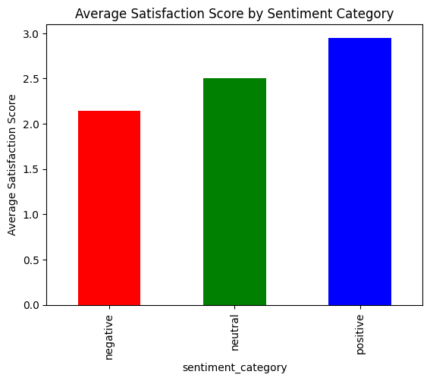
Satisfaction analysis
Sentiment Category | Satisfactory score
negative | 2.14
neutral | 2.50
positive | 2.95
Satisfaction analysis
Mapping the sentiment scores (from -1 to 1) into satisfaction scores (from 1 to 5) to show how our clients are satisfied with our service. We have already categorized our sampled reviews into 3 groups: positive, neutral, and negative. This step is to see the satisfaction score of each group.
Result:
We have 62.7% positive reviews. This group of clients hold the highest satisfaction score as 2.59/5. The sample size of neutral evaluation is too small to be useful for reference. The negative group holds a satisfaction score of 2.14, 0.84 less than the positive group.

Slide 10
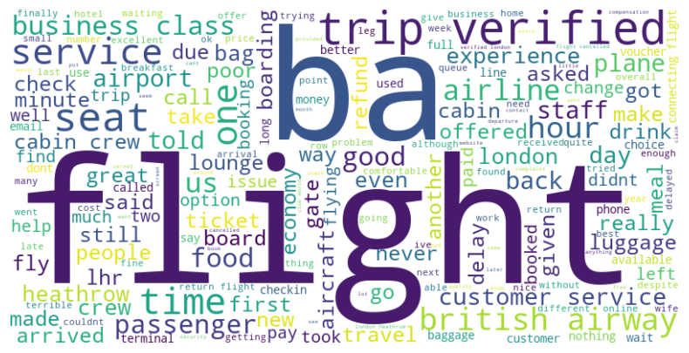
Word cloud
Word could visualization:
The size of words in a word cloud is usually proportional to their frequency of occurrence in the text,
Some explanation on major words:
flight/ba:
These are biggest words in this visualization, which form the core topic of our sampled reviews: British Airways’ flights.
Time/service/trip/seat:
These might indicate that the flight time, service quality, trip experience, and seat evaluation are highly mentioned and focused by our clients. These could relate to cases that our clients are reviewing about the overall evaluation of cabin comfort , service quality, and the on-time rate of the flight.
Passenger/food/business class/hour/drink/luggage/boarding…:
These might indicate that our clients’ reviews which focus on the service quality of different classed of the cabins, especially on the drinks and foods. Our clients also mentioned the luggage checking in and claiming, the boarding experience, and flight hours, etc.

Slide 11
Conclusion and insights
Most of our customers have a positive view of us. Our services and products provide a positive experience and leave a positive impression on most of our customers. This is an optimistic start to our reviews analysis.
The top three topics of concern in customer reviews are: the negative impact of flight delays and cancellations on the travel experience; seat comfort and cabin service quality in first and business class; seat comfort and cabin service quality of economy class. These can also be visually seen from the word cloud visualization. These areas could be focused on in future service improvement plans.
The difference between the positive and negative groups was not large, indicating that even customers who had negative opinions about us were not extremely dissatisfied with our service. But it also shows that the overall satisfaction score of all customers is not high, which is less than 60% (3 scores), and there is still a lot of room for improvement.

Slide 12
Thank you ! Q&A Session

